Slide 1
Knapsack Simulation Problem
By : Ahmed Reda Mohamed
No : 2004-3-333

Slide 2
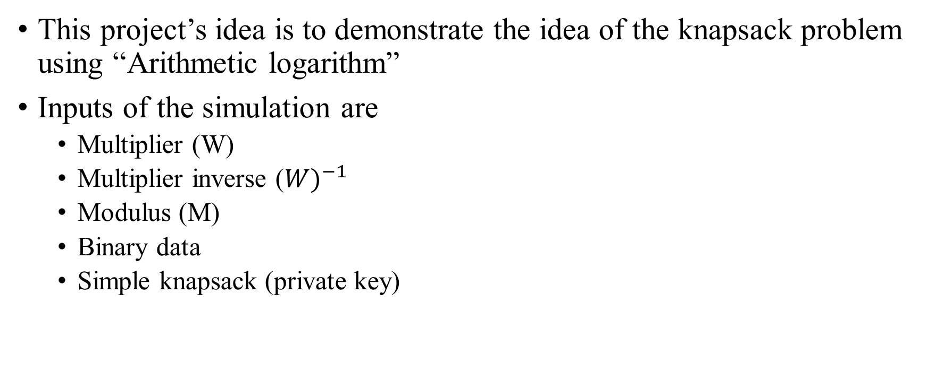
Demonstration
This project’s idea is to demonstrate the idea of the knapsack problem using “Arithmetic logarithm”
Inputs of the simulation are
Multiplier (W)
Multiplier inverse (${W)}^{−1}$
Modulus (M)
Binary data
Simple knapsack (private key)

Slide 3
Demonstration Cont.
This project is written in Python 2.7
__main__.py is the starting point of the project
Simulation Phases:
Inputs
Encryption
Decryption

Slide 4
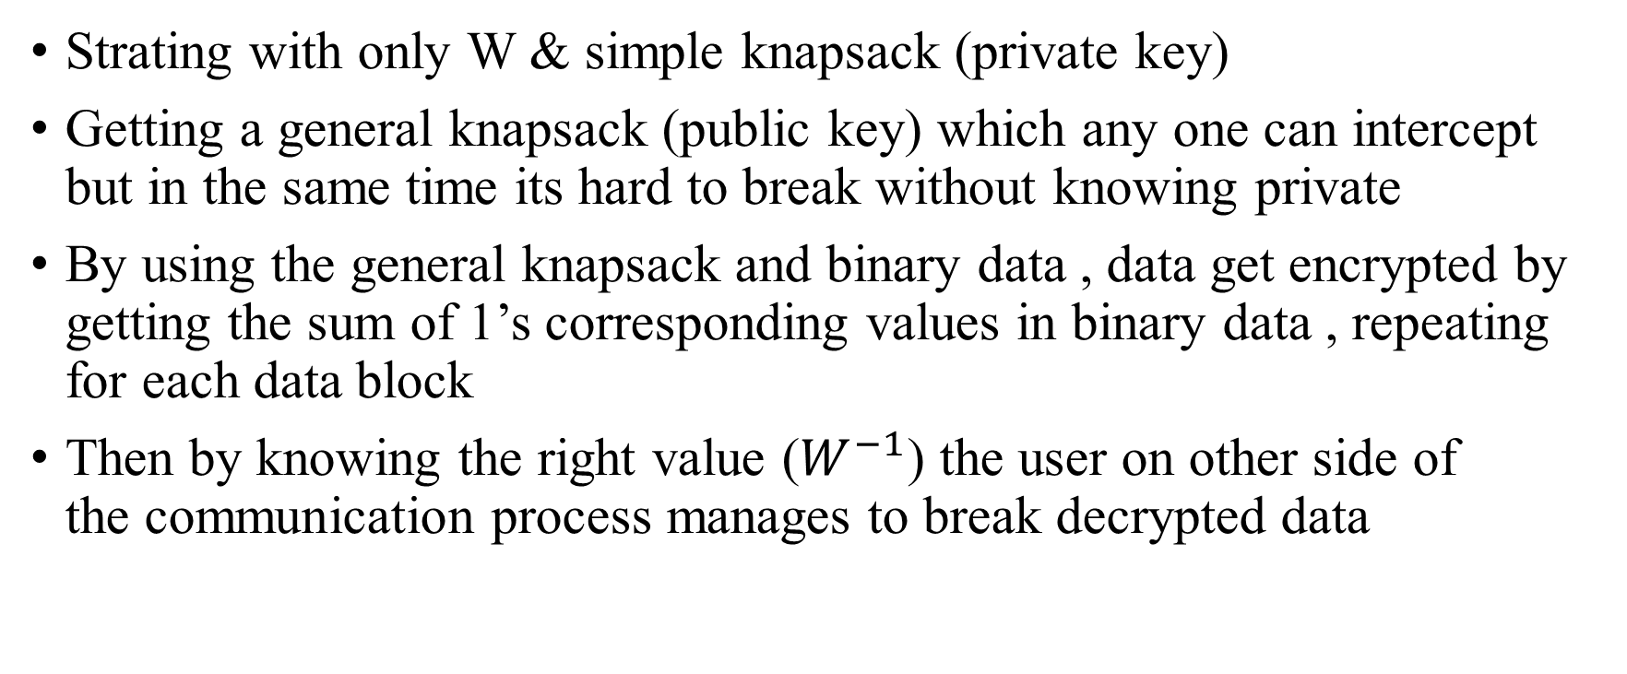
Simulation Idea
Strating with only W & simple knapsack (private key)
Getting a general knapsack (public key) which any one can intercept but in the same time its hard to break without knowing private
By using the general knapsack and binary data , data get encrypted by getting the sum of 1’s corresponding values in binary data , repeating for each data block
Then by knowing the right value ($W^{−1}$) the user on other side of the communication process manages to break decrypted data

